Slide 1
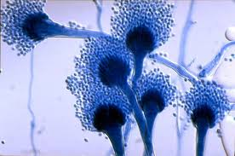
Mycology
Dr. Bincy Joseph
Assistant Professor
PGIVER, Jaipur

Slide 2
Mycology
Fungi are eukaryotic non photosynthetic heterotrophs which produce exoenzymes and obtain nutrients by absorption
There are four phyla in the Kingdom Fungi
Ascomycota (Ascomycetes)
Basidiomycota (Basidiomycetes)
Zygomycota (Zygomycetes)
Fungi imperfecti (deuteromycetes)
The first three phylum can be distinguished by the characteristics of their sexual form
In case of fungi imperfecti/ Deuteromycetes the sexual form has not been found
The sexual form of fungi also known as teleomorphs
Most fungi of Veterinary importance are under Deuteromycetes

Slide 3
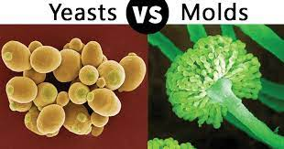
Moulds and Yeast
Two main morphological forms of fungi are molds and yeasts
Molds grow as branching filaments called hyphae (2-10μm) diameter where as unicellular yeasts have an oval or spherical appearance 3-5 μm in diameter
Dimorphic fungi occur in both yeast and mold forms
Some fungi like Candida albicans produce other forms in addition to mold and yeast form, hence they are known as polymorphic

Slide 4
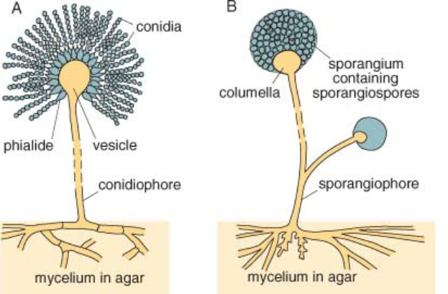

Slide 5
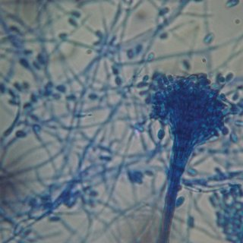
Characteristic of fungi
Fungi are aerobic
Reproduction in fungi occur either sexually or asexually by the formation of spores
A mass of interlacing hyphae form mycelium
Fungi tolerate high osmotic pressure and acidic environments as low as pH 5.0
Structure
Hyphal cell wall contain carbohydrate components like chitin macromolecules with cellular cross linkages
In Yeast cell wall contain protein complexed with polysaccharide and lipids
The predominant sterol is ergosterol in contrast to cholesterol which is the predominant sterol in the cell membrane of animals

Slide 6
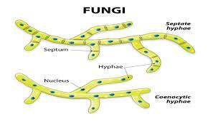
Both molds and yeast have well defined nuclear membrane, mitochondria and a network of microtubules
Septa or cross walls often present on the hyphae
Septa formed by the inward growth of cell wall have central pores through which nutrients and organelles may pass

Slide 7
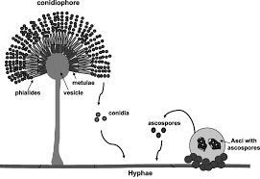
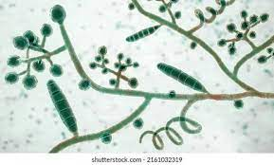
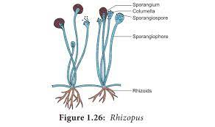
Growth reproduction and colonial formation
Moulds tend to form large colonies with growth and extension of hyphae at their peripheries.
In moulds in asexual reproduction two main types of spores are produced
Conidia –produced on conidiophore
Multicellular conidia called macro conidia and unicellular conidia called micro conidia are produced by Dermatophytes produced on the lateral branches of hyphae
Sporangiospores produced within a sac like structure called sporangium on an aerial hyphae called sporangiophore
Eg: By fungi in the phylum zygomycota

Slide 8
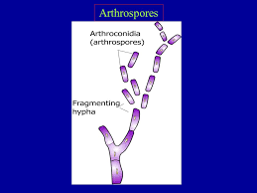
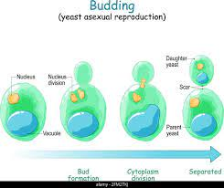
Arthroconidia are the conidia produced by the disintegration of hyphae within keratinised tissues
In most yeast cells asexual reproduction is by budding
Daughter cells separate from parent cells after the formation of crosswall at the point of budding
The colonies of yeast like fungi are soft smooth and round

Slide 9
Asexual spores
Arthroconidia or Arthrospore
Spores are produced and are released during the process of fungal fragmentation
Spores may be produced successively as in dermatophytes or intervening empty cells as in coccidiodes
Blastoconidia/Blastospore
Conidia which are produced by budding
Eg: Candida albicans
Chlamydoconidia/ Chamydospores
Thick walled resistant spores which contain storage products.
These are produced by some fungi in unfavourable conditions

Slide 10
Macro conidia
Large multicelled conidia which are produced by Dermatophyte in culture
Micro conidia
Small conidia are produced by certain dermatophytes
Phialo conidia
Conidia produced from phialids
The Phialides of Aspergillus species arise from a vesicle
Sporangiospores
Spore produced by zygomycetes such as rhizopus are released when mature sporangium ruptures

Slide 11
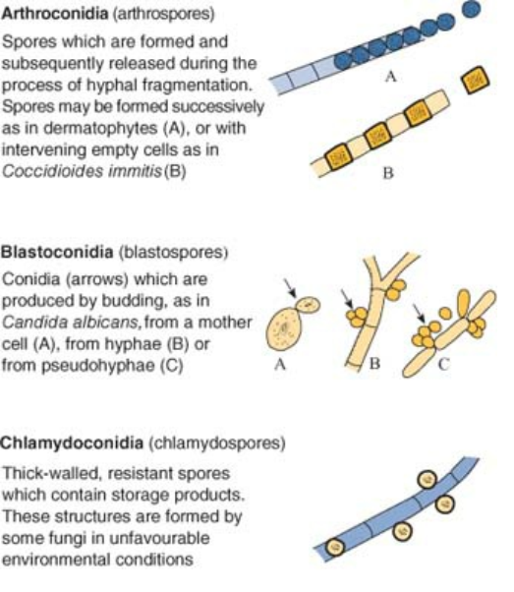

Slide 12
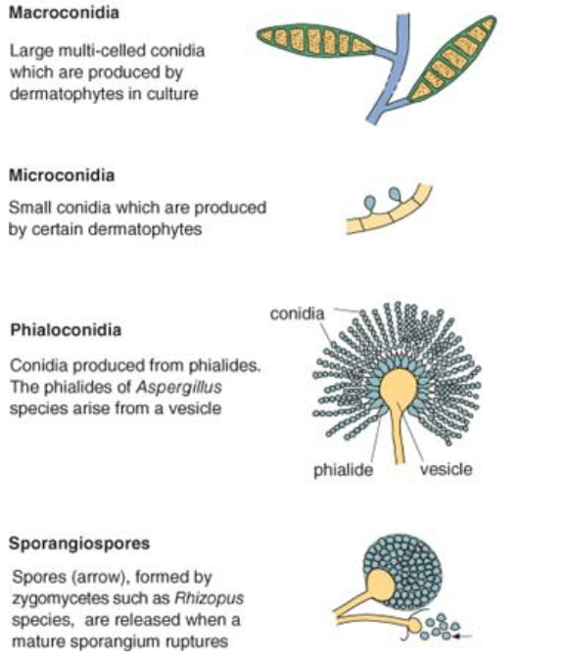

Slide 13
Sexual spores
Sexual spores are produced by fungi in the phyla
Ascomycota
Basidimycota
Zygomycota

Slide 14
Ascospores
Produced by members of Ascomycota. Ascospores are developed in a sac like structure called an ascus
Asci are enclosed in a well defined structure termed ascocarp
Basidiospores
Produced by members of Basidiomycota on a club shaped structure called basidia
Zygospores
Produced by members of zygomycota
Develop within a thick walled zygosporangium formed by the fusion of side projections of two compatable mycelium

Slide 15
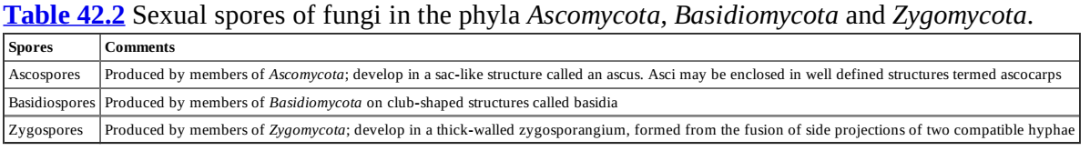

Slide 16
Reproduction in zygomycetes
Asexual reproduction
Long non septate aerial filament called sporangiophore which have an expended tip called columella
Surrounding which is a sac like closed structure called sporangium
Sporangium contains numerous asexual spores called sporangiospores.
When spores mature, the sporangium ruptures and sporangiospores are released to initiate new hyphae and fungus

Slide 17
Sporangiospores are two types
Aplanospores are non motile containing several nuclei
Zoospores uninucleate and motile with one or more flagella
All the species have horizontal hyphae which grows along with the surface of the medium
It has got root like branched hyphae extending into the medium called rhizoids
The horizontal hyphae or runner is known as stolon
In mucor species rhizoids are absent
In absidia rhizoids are away from sporangiophore and in rhizopus the rhizoids are situated just below sporangiospores

Slide 18
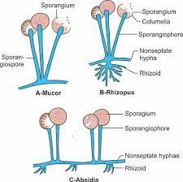

Slide 19
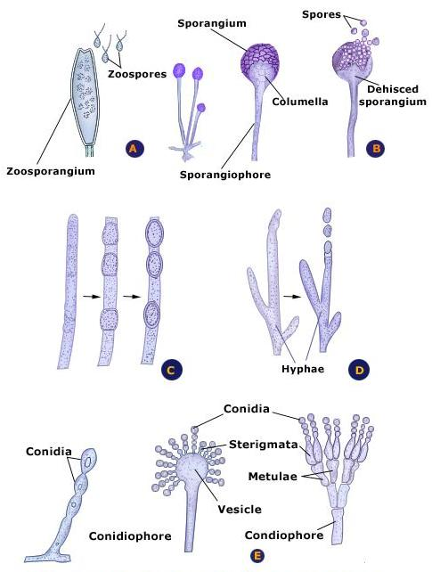

Slide 20
Sexual reproduction
Two types
By fusion of like gametes
By fusion of unlike gametes
In the first two suitable adjacent hyphae come together and form short side branches called suspensors
At the point the suspensors meet , a gametangium is formed
The gametangia formed fused to form a zygote
The zygote matures and produce spherical thick walled sexual spore called zygospore

Slide 21
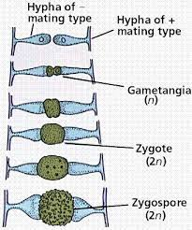

Slide 22
In the second type there is specialised female structure called oogonium fertilised by transfer of nucleus from the male structure called antheridium
The sexual spore formed is called oospore. The structure which contain the oospore is called oosphere

Slide 23
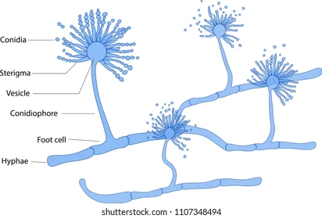
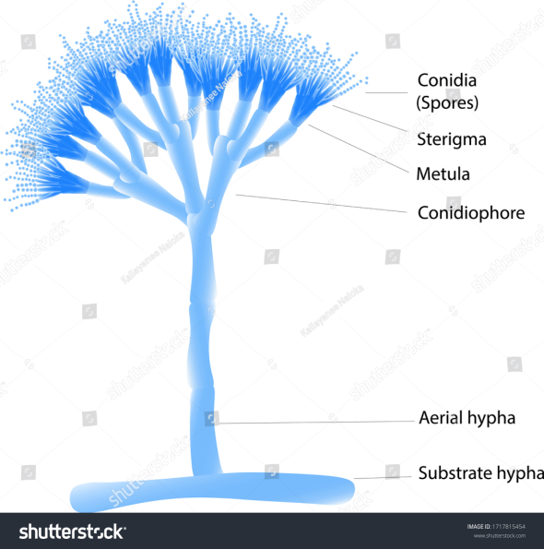
Reproduction in ASCOMYCETES
Asexual reproduction
Aspergillus spp. produce long septate aerial modified hyphaae known as conidiophore which ends in terminal expansion or swollen called conidiophore vesicle.
From surface of vesicle numerous club shaped structures called sterigmata or phialides arise.
From tip of sterigmata, unicellular long chain of asexual spores which may be uninucleate or multinucleate
In Penicillium species the conidiophore vesicle is absent
It produce lateral side branches called metullae from end of which finger like projections (sterigmata) arise which has asexual spores
This arrangement gives penicillium species a characteristic brush like appearance.
Asexual spores of aspergillus and and penicillium spp. are called conidia or conidiospores (phialospores and phialoconidia)

Slide 24
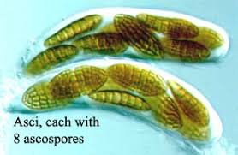
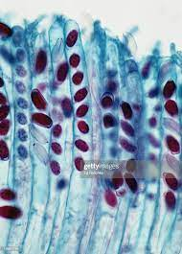
Sexual reproduction
Sexual spores are developed endogenously in a rounded or elongated sac like structure called ascus
The spores fromed inside are called ascospores
Usually one ascus has 4 to 8 ascospores.
Ascus may be formed within a fruiting body called ascocarp.
Ascocarp are of two types
Cleistothecium type- which is largely fairly round closed many celled structure in which asci or ascocarps are formed
Perithecium which is a large round or pear shaped structure containing small rounded opening.it contains asci and ascospores
Apothecium discoid or cupped body bearing asci on the exposed flat or concave surface.

Slide 25
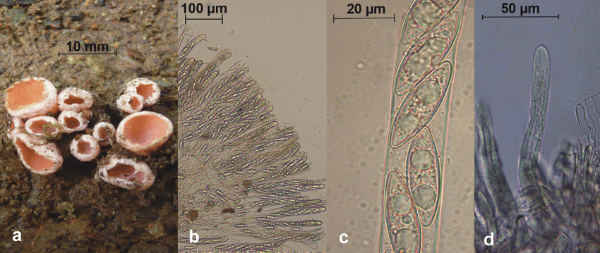
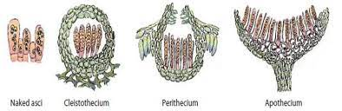

Slide 26
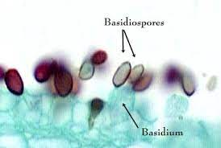
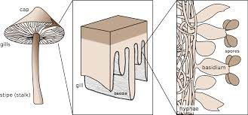
Reproduction in Basidiomycetes
Asexual reproduction by production of conidia
Sexual reproduction – sexual spores develop exogenously on a club shaped structure called basidium
Sexual spores are called basidispores usually basidium bears four spores

Slide 27
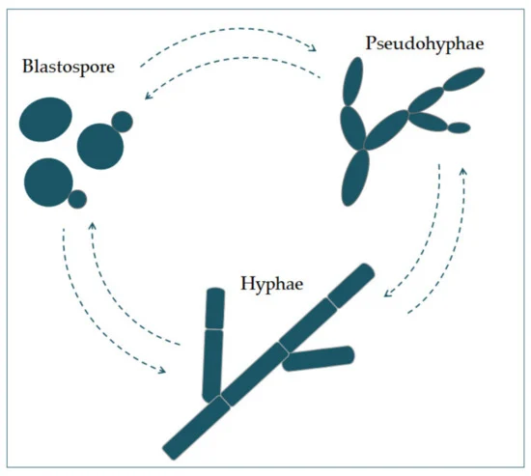
Deuteromycetes- Fungi inperfecti
Only asexual reproduction seen
Asexual spores of Deuteromycetes are called as thallopores
They are derived from original hyphae itself, not from modified ones
Blastospores/bastoconidium in yeast : Spores produced from budding process from vegetative cells or from a hypahe
The bud constrict at the base and detach from mother to reproduce further by budding
It is seen in Candida albicans and Cryptococcus neoformans
Pseudohyphae – filaments composed of elongated budding cells that failed to detach in Candida albicans

Slide 28
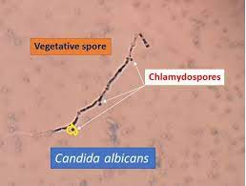
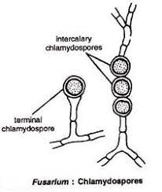
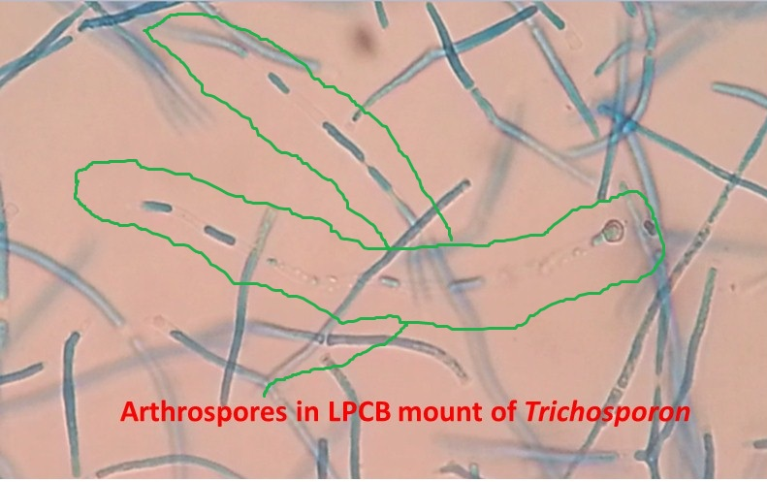
Chlamydospores: Thick walled resistant spores formed by the direct differentiation of hyphae.
It is seen in Candida albicans and Histoplasma capsulatum
Arthrospores
Formed by fragmentation of hyphae. It is very common in dermatophytes
In addition dermatophytes produce macro conidia and microconidia
Microconidia: very small asexual spores of various shapes and size which may occur on side of hyphae “ en thyrse” or in clusters “en grappe”

Slide 29
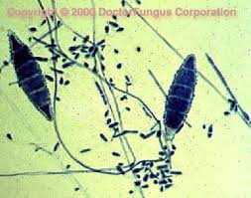
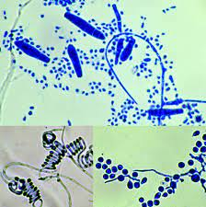
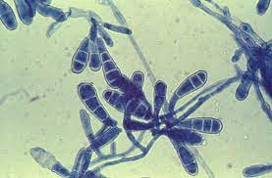
Macro conidia
Usually larger and elongated
In microsporum spp. they are multiseptate, fusiform or spindle shaped some time thick walled or with wrinkled wart like walls
In Trichophyton spp. they are long thin multiseptate, smooth walled and cigar shaped
In Epidermophyton spp. oval or pear shaped and have only few septa

Slide 30
In addition dermatophytes produce abnormal hyphal forms like
Racquet hyphae
Composed of chain of individual elongated hyphal cells expanded at one end and resemble a tennis racquet
Spiral or coiled hyphae
Coiled or cork screw shaped which resemble the shape of plant tendrils
Pectinate hyphae
Resemble tooth of a comb
Favic Chandliers
Irregular projections on one or both side of hyphae similar to antlers/ stag horns (very characteristic of Trichophyton schoenleinii)
Nodular body : hyphae may intervene and form hard dormant nodular bodies

Slide 31
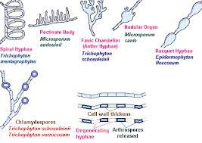

Slide 32
mycoses
Diseases caused by fungi is called mycoses
Disease are three types based on the tissues affected
Superficial mycoses/ Dermatomycoses
S/c or Intermediary mycoses
Deep / visceral or systemic mycoses

Slide 33
Sperficial mycoses- Dermatophytosis
Caused by Dermatophytes
generally known as ring worm fungi.
This require keratin for their growth and affect stratum corneumof skin hair nail etc
there are three important genera
Trichophyton
Microsporon
Epidermophyton
This organism are classified under Ascomycetes

Slide 34
Based on tropism dermatophytes are classified as
Zoophilic- present in animals
M. canis and Trichophyton verucossum
Geophilic : Natural habitat is soil
M. gypseum
M. nanum
T. simii
Anthropophilic: Primarily nfect human being
T. rubrum
E. floccosum

Slide 35
The disease produced by Trichophyton and microsporon in human being is called Tinea
Both microsporon and Trichophyton produce disease in animals and human being
Trichophyton will affect skin, hair and nail
Microsporum will affect skin and hair
Epidermophyton affects nail and skin

Slide 36
Important species are
Trichophyton | Microsporon | Epidermophyton
T. verrucosum, T. Equinum T. Violaceum T. Mentagrophytes T. Schoenlenii T. Gallinae T. simii | M. nanum M. Distortum M. Gypseum M.Canis M. Audouini M. gallinae | Epidrmophyton floccosum

Slide 37
pathogenesis
These organism cause hydrolysis of keratin
As a result of infection the host mount inflammatory response
Organism can not thrive in an area of intense infection and will move to periphery
so it will produce ring like lesions
Central area will have heated appearance and inflammed periphery
Lesions are by toxins, allergens and enzymes like keratinase and collaginase

Slide 38
Disease in foru forms
Subclinical
Classical ring worm
Generalised form
Kerion / tumor like lesions in dogs

Slide 39
Clinicla signs
In dogs and cat important organism is Microsporon canis
Main lesion occur in face and extremity
it will produce crusty alopecia lesion
in cattle important organism is Trichphyton verucosum and T. mentagrophytes
lesions mainly in face and neck region
Extent of lesion may vary
it can be mild infection characterised by eruption and alopecia
Chronic lesions are yellowish brown, very thick asbestose like

Slide 40
In horse Trichopyton equinum and Trichophyton mentagrophytes lesions are seen in withers, saddle and girth.
Lesion can be either urticarial eruption or deep ulcerative nodule
In sheep and goat organism are Trichophyton veerrucosum and T. mentagrophytes
In pigs
T. verrucosum
T. mentagrophytes
M.nanum
In pig urticarial lesion on the base of ear and trunk

Slide 41
In poultry
T. gallinae
M.galline
disease is known as avian ring worm or favus
Disease seen as white patchy crust on comb and wattle

Slide 42
Diagnosis
Symptoms and lesions
Ring worm appearance
Examination of infected hair usin Wood’s lamp or UV lamp
If infected hair is shown on wood lamp, there will be apple green flourescencedue to the production of metabolite of Tryptophan by the organism
In positve infection by M canis, M. distortum and M. audonii
False positive with dandruff or application of salicylic acid or petroleum jelly

Slide 43
Direct microscopical examination of skin scrapping ot hair
Before collection of these , clean the area with 70% alcohol. Scrape skin from old and new lesions with blunt scalpel or razor blade untill blood oozes to come out
Better to pluck hair
Take skin scarpping or hair o n a clean slide and add 2-3 drop of 10-20 % KOH ( Keratlytic). Gently warm the slide at 60oC for 5-1 minutes. Put coverslip and examine under low and high power
KOH cause partial digstion of Keratin leading to clearing of specimen

Slide 44
Stain with lactophenol cotton blue
In DME of arthrospores of fungi. Most fungal agents of animals, spores can seen on external surface of hair and such arrangement called ectothrix
M. canis
T. verrucosum
T. mentagrophytes
In some other case large spore arranged lineraly within hair shaft called endothrix
T. violaceum
T. schoelleiniialong with spore. Large number of air bubbles also seen
T. gallinae, T, simii, T,rubrum will not affect hair

